Slide 1
Wine Quality Prediction using Machine Learning Algorithms
Yuexin Yu, Jingwen Ling, Vaidy Krish

Slide 2

Wine
Wine is an alcoholic beverage made with the fermented juice of grapes
Four Types of Wine
Red wine
White wine
Rose wine
Sparkling wines/champagne.

Slide 3
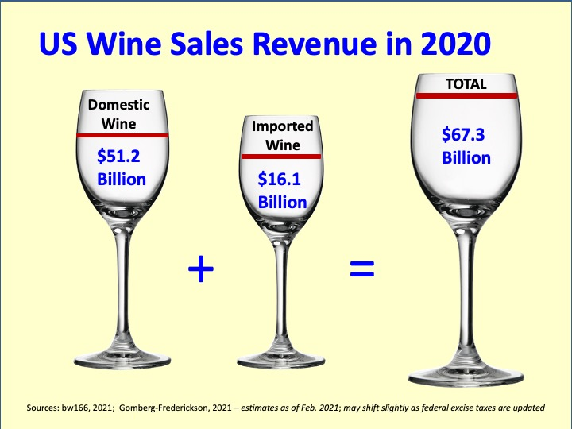
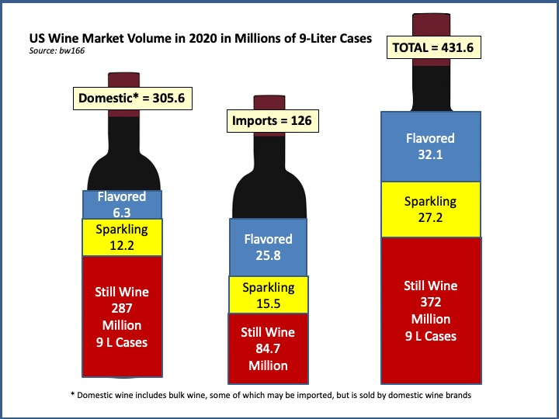
Wine Market in the U.S.
The USA is the world’s largest wine market, with the largest population of regular wine drinkers. In 2020, the USA market consumed 126 million cases of imported grape wine valued at nearly $US 16 billion

Slide 4
Objective
Explore and visualize the dataset.
To predict which customers will purchase the long term travel package
Which variables are most significant.
Build using various machine learning models predict …..
Generate a set of insights and recommendations that will help the business to understand which wine has the highest quality.

Slide 5
Data Information
Attributes’ information about the datasets (winequality-red.csv and winequality-white.csv)
Input variables (based on physicochemical tests):
1 - fixed acidity
2 - volatile acidity
3 - citric acid
4 - residual sugar
5 - chlorides
6 - free sulfur dioxide
7 - total sulfur dioxide
8 - density
9 - pH
10 - sulphates
11 - alcohol
Output variable (based on sensory data):
12 - quality (score between 0 and 10)

Slide 6
Exploratory Data Analysis

Slide 7
Data Preprocessing
Missing Value:
Outlier Detection:
Data Type conversion of columns :

Slide 8
Model Building Steps & Evaluation Criteria
Data preparation
Partition the data into train and test set.
Build model on the train data.
Tune the model if required.
Test the data on test set.
Model evaluation criterion
Model can make wrong predictions as:
Which case is more important?

Slide 9
Model Performance Evaluation & Improvement

Slide 10
Model Tuning

Slide 11
Model Comparison with and without Tuning

Slide 12
Model Performance Evaluation and Improvement-Boosting

Slide 13
Model Performance Improvement using Hyperparameter Tuning
Hyperparameter Tuning was performed for :
Stacking Classifier

Slide 14
Comparison of all models

Slide 15
Feature Importance of each models

Slide 16
Business Recommendations and Insights
We can use the model to predict the quality of wine using the following insights.

